Slide 1
Arduino Soil Moisture Probe
Tyler Brown and Evan Lesmez

Slide 2
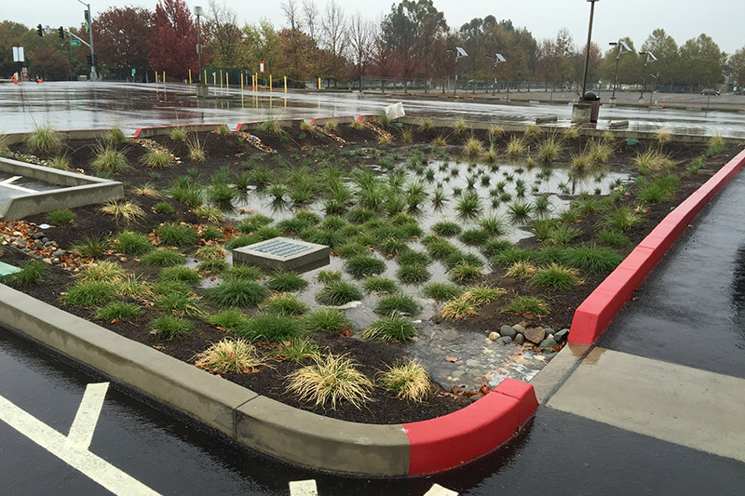
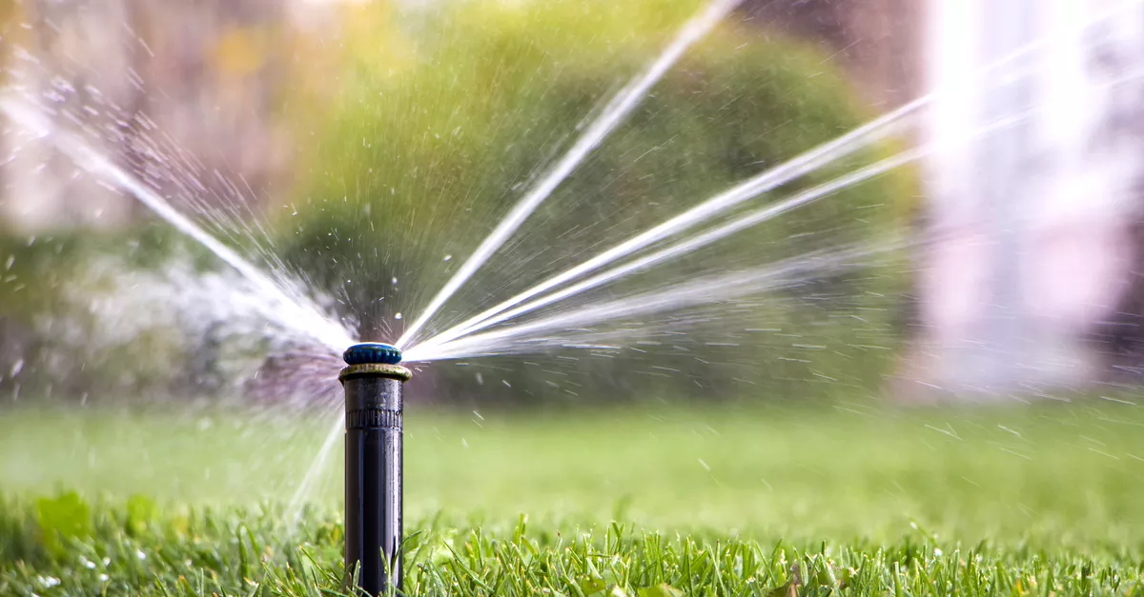
Goals
Remotely monitor soil moisture in Engineer’s Way bioretention system
Relate soil moisture data to rainfall events and optimize water flow
Create a soil moisture probe using cheap and readily available equipment
Make a product that is easily reproduced and can be used in a variety of applications
Homes, gardens, irrigation systems, etc.

Slide 3
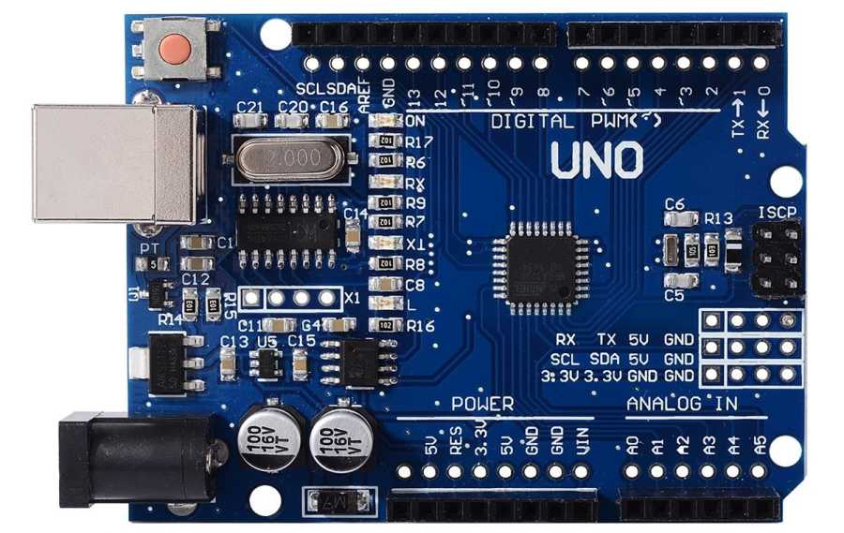
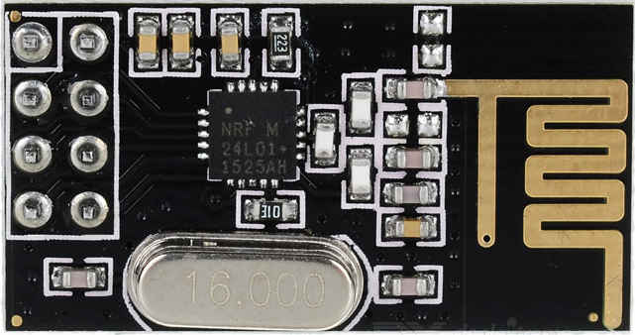
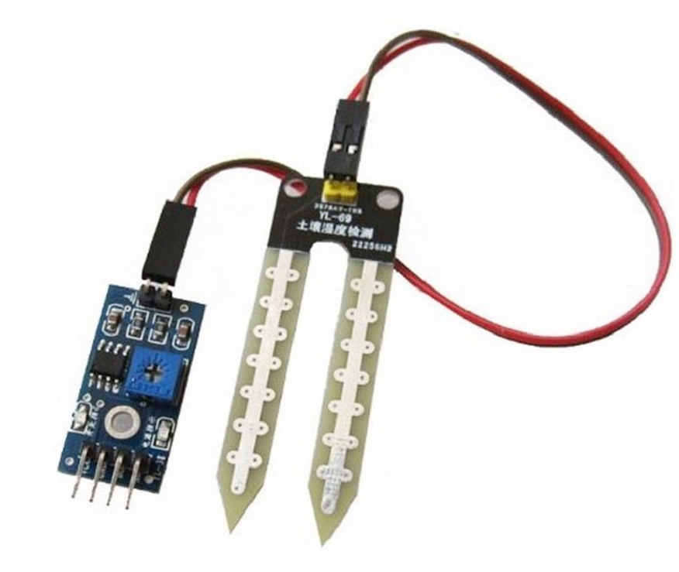
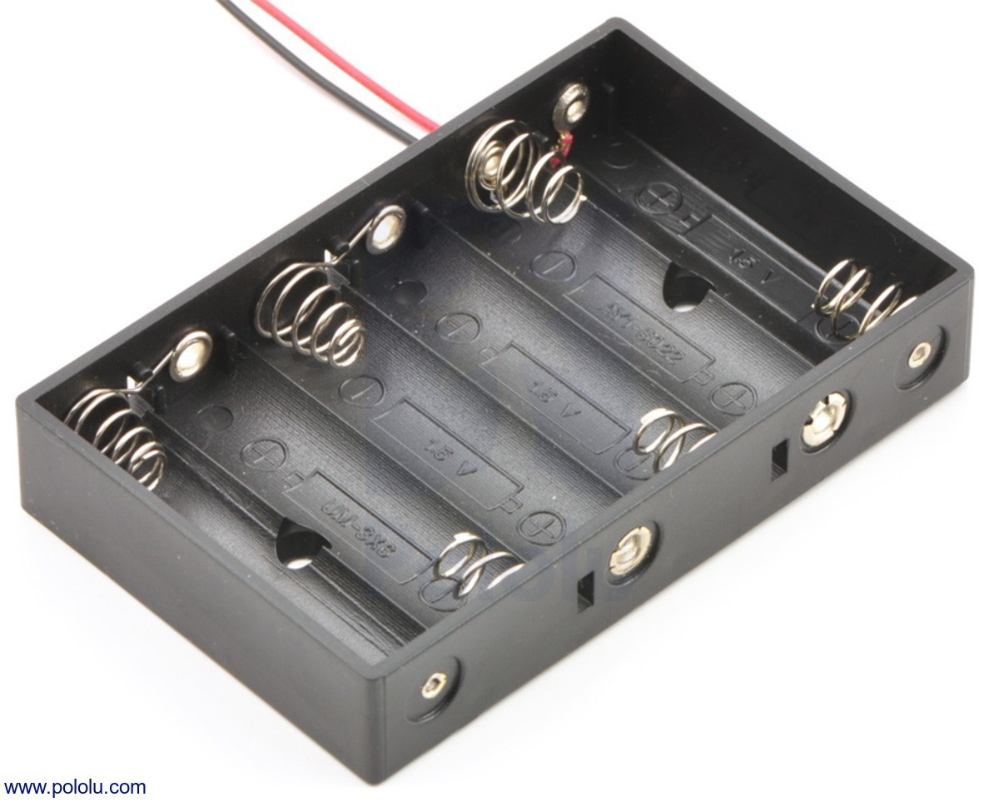
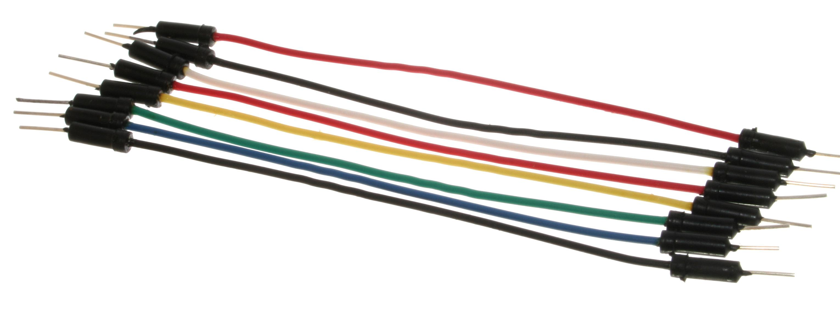
Equipment
NRF24L01 Radio Transmitter (2x)
Total Cost: $20
Arduino Uno Board (2x)
WINGONEER YL-69 Sensor and HC-38 Module
Colored Wire with pins for Arduino (18x)
AA Battery Pack (connects 6 in series)

Slide 4
Setup
Moisture Probe, Arduino, Radio Transmitter, and battery pack deployed in bioretention system
Waterproof plastic container with slot for probe
Radio receiver and Arduino connected to PC in Thornton B-Wing
Probe gathers moisture data, transmits to receiver, and uploads to PC
All data sent to Blynk server, which can be viewed via Blynk mobile app

Slide 5
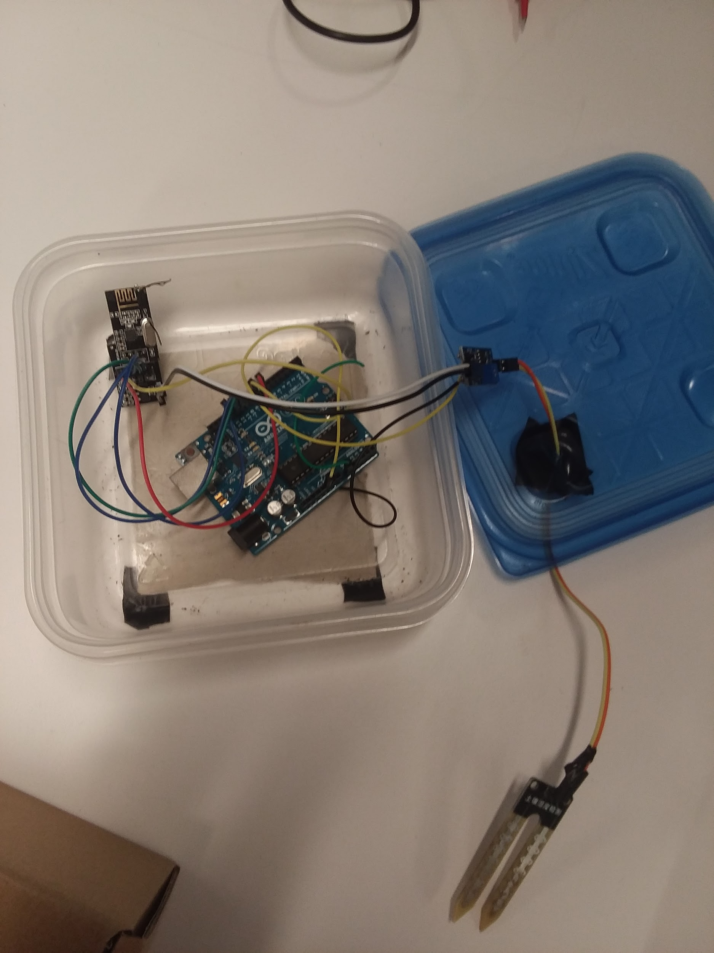
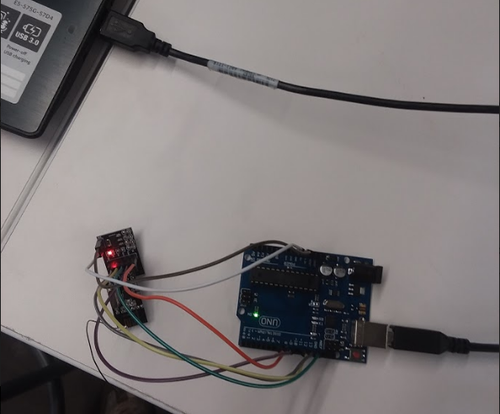

Slide 6
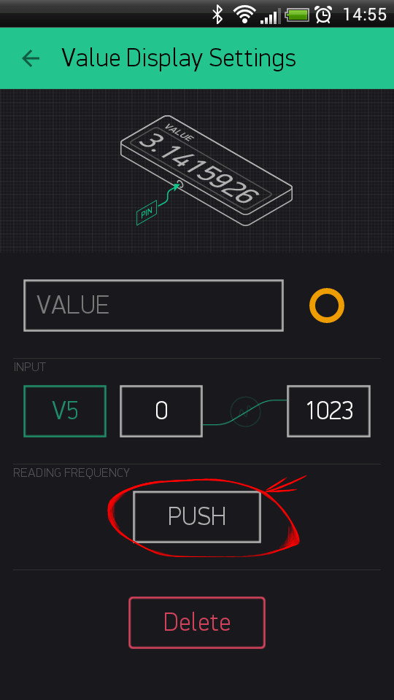
Program
All coding in the Arduino IDE, required importing different libraries all shown in the Git repository:
RF24 for radio communication
Blynk for posting data to server
Only two scripts required
Transmitter records and sends data (RadioTransmit)
Receiver records and uploads data (RadioBlynkReceive)
https://github.com/uva-hydroinformatics/Soil_moisture_and_Rainfall_sensing

Slide 7
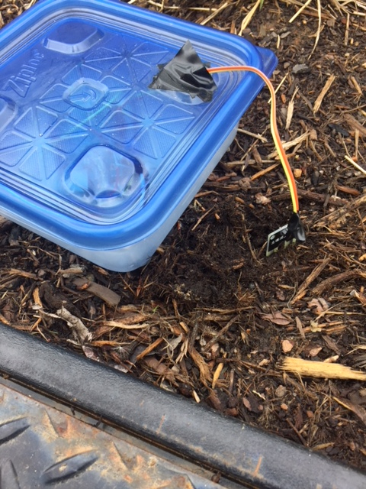
Testing
Put the transmitter setup out in the rain garden for a week
Receiver was in nearby room hooked up to a computer
Data was recorded and posted every 30 seconds
Blynk app: utilized history graph widget
Soil moisture levels were obtained and plotted in real time

Slide 8
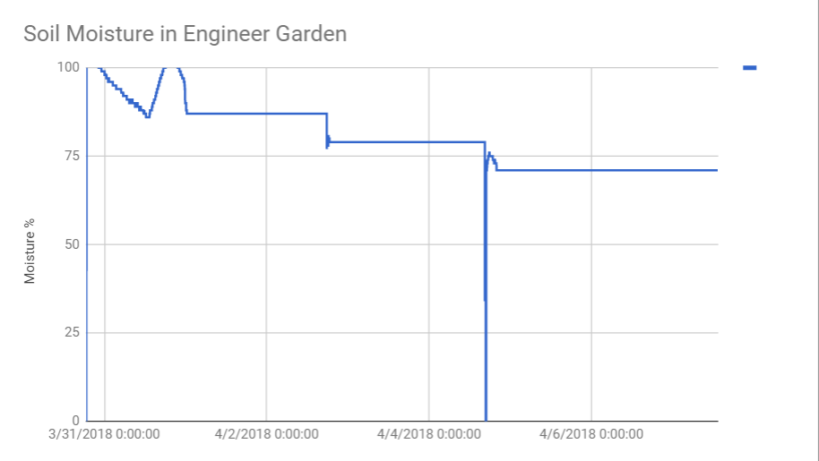
Results
Overall successful. Soil moisture plotted over the course of a week
Data collected & posted on the Blynk-server
Exported to a CSV and graphed →
Demonstrated at the UVA SEAS open house
Rapid data collection
Instant plotting

Slide 9
Obstacles and Solutions
Probe Calibration
Code must scale probe output to match actual moisture levels. Calibrated with pure water (100%) and a dry paper towel (0%)
Radio Transmission Range
Short range boosted with soldered antennas
Arduino Shield offers wifi capability for future projects
Battery Life
Frequent transmission drains batteries quickly (roughly 30,000 transmissions per battery pack)
Storing data locally and sending less frequent packets dramatically increases lifetime

Slide 10
Future Work
Pair with tipping bucket that measures rainfall intensity and depth
Correlate rainfall depth with soil moisture levels, increase predictability
Similar wireless transmission and data logging
Use probe to automate valve controls
Moisture too high → Open drainage valves
Low moisture → close valves, activate sprinklers, etc.
Improve sturdiness of design
Solder pins, build robust container, larger battery pack

